Slide 1

Factor Analysis
Review and Examples

Slide 2
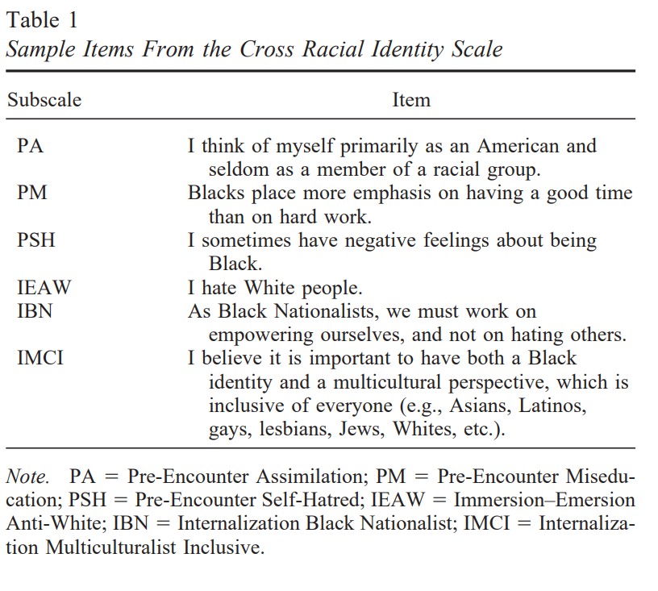
What is factor analysis: Definitions
In Social Work, we use many measures to capture different ‘constructs’
  Examples: ???
  To be representative of the underlying construct, the variables should ‘cluster’ together around that construct
  Recall the construct is called the latent variable
Vandiver, B. J., Cross Jr, W. E., Worrell, F. C., & Fhagen-Smith, P. E. (2002). Validating the Cross Racial Identity Scale. Journal of Counseling psychology, 49(1), 71.
Notes:
The underlying factor explains the interrelationships between the variables
EFA is an integral method in the research process and s
depression, PTSD, life satisfaction, ACEs cale development
Example – Racial Identity Attitude Scale
the RIAS–B has been used to examine the relationship between the Black racial identity constructs and numerous variables, including academic achievement (Hood, 1998), acculturation (Morrow, 1998), gender role conflict (Wade, 1996), psychosocial competence (Carter, DeSole, Sicalides, Glass, & Tyler, 1997), self-actualization (Parham & Helms, 1985b), self-esteem (Dartson, 1999; Manning, 1998; Parham & Helms, 1985a), social class (Carter & Helms, 1988), and student involvement (Taylor & Howard-Hamilton, 1995)

Slide 3
What is factor analysis: Definitions
We use factor analysis to statistically justify the construct
  FA analyzes the structure of the interrelationships among many variables in a concise but accurate manner
  This aids in conceptualization by identifying variables that do not fit the construct and by developing the underlying factors
FA reduces items from a larger set of items that do not share a ‘sufficient’ amount of variance with the other items in the set

Slide 4
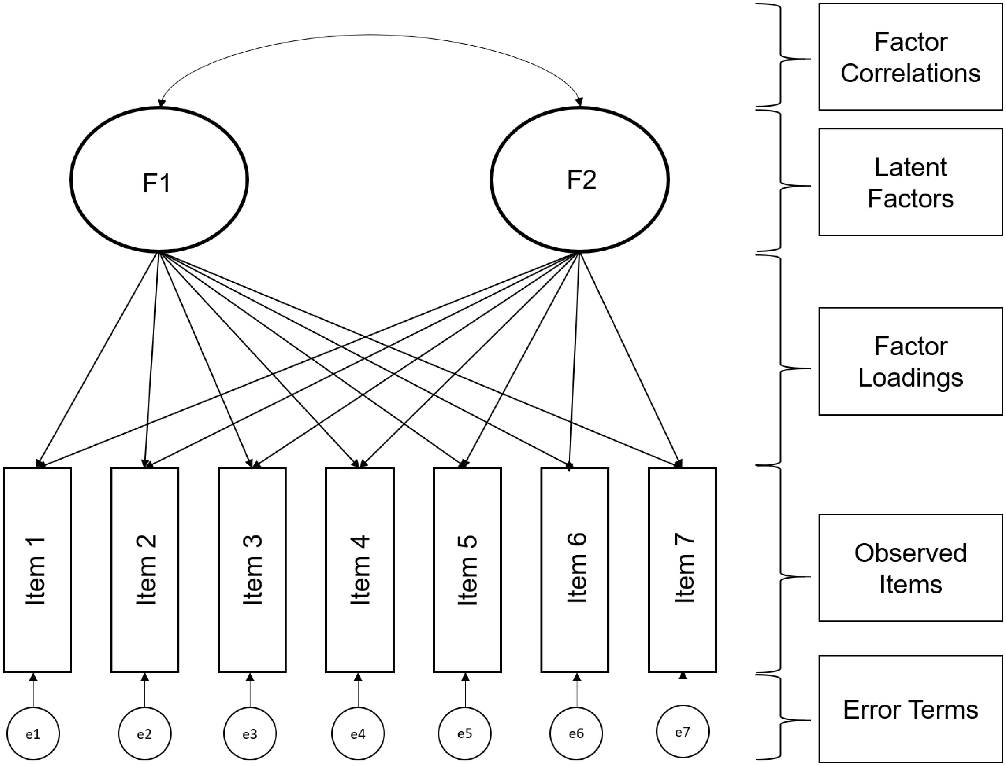
Statistical Model
EFA does not presuppose a theoretical structure
Useful as a starting point for understanding empirical structures or identifying problems with existing scales
Correlations between items are used to infer the presence of an underlying variable (latent)
Cross loadings: One important consideration is that all items are allowed to load on any factor (compare CFA)

Slide 5
Research Questions
How many reliable and interpretable factors/components are there in a set of variables?
How many factors/components should be extracted?
How much variance in a set of variables is accounted for by the retained factors/components?
How are the factors/components interpreted? (Note: this is subjective)

Slide 6
EFA Steps with Factor Extraction
Decisions before running the analysis
  Association Matrix generation
    Run the correlation matrix between variables
  Method of extraction (2)
    The way you will estimate the variability explained by the input items to generate a parsimonious set of factors
    We use Maximum Likelihood Estimation (MLE)
  Method of rotation
    Refers to changing of the scale of the factor data ‘vectors’ over an n-dimensional space
    Two categories
      Orthogonal – assumes the factors are uncorrelated
      Oblique – allows for the factors to be correlated
        We use an oblique rotation, such as promax (??)

Slide 7
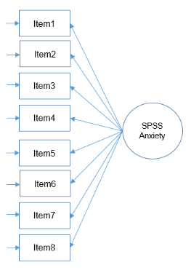
Example: STATISTICS ANXIETY
Statistics makes me cry
My friends will think I’m stupid for not being able to cope with SPSS
Standard deviations excite me
I dream that Pearson is attacking me with correlation coefficients
I don’t understand statistics
I have little experience of computers
All computers hate me
I have never been good at mathematics
Stats Anxiety
Question: what constitutes the systematic and random error for item 3?
Notes:
In FA we are assuming that the underlying factor called “stats anxiety” is driving the variables (plus error)
Notice the arrow points from the factor to the variable

Slide 8
Correlations (what factor(s) might Cause the relationships?)
Part I Original Correlation Matrix
 | V1 | V2 | V3 | V4 | V5 | V6 | V7 | V8 | V9
V1 Price Level | 1.00
V2 Store Personnel | .427 | 1.00
V3 Return Policy | .302 | .771 | 1.00
V4 Product Availability | .470 | .497 | .427 | 1.00
V5 Product Quality | .765 | .406 | .307 | .427 | 1.00
V6 Assortment Depth | .281 | .445 | .423 | .713 | .325 | 1.00
V7 Assortment Width | .345 | .490 | .471 | .719 | .378 | .724 | 1.00
V8 In-store Service | .242 | .719 | .733 | .428 | .240 | .311 | .435 | 1.00
V9 Store Atmosphere | .372 | .737 | .774 | .479 | .326 | .429 | .466 | .710 | 1.00

Slide 9
Factor Structure
Part II Correlation Matrix After Grouping According to Factor Analysis
 | V3 | V8 | V9 | V2 | V6 | V7 | V4 | V1 | V5
V3 Return Policy | 1.00
V8 In-store Service | .773 | 1.00
V9 Store Atmosphere | .771 | .710 | 1.00
V2 Store Personnel | .771 | .719 | .737 | 1.00
V6 Assortment Depth | .423 | .311 | .429 | .445 | 1.00
V7 Assortment Width | .471 | .435 | .466 | .490 | .724 | 1.00
V4 Product Availability | .427 | .428 | .479 | .497 | .713 | .719 | 1.00
V1 Price Level | .302 | .242 | .372 | .427 | .281 | .354 | .470 | 1.00
V5 Product Quality | .307 | .240 | .326 | .406 | .325 | .378 | .427 | .765 | 1.00

Slide 10
Is factor analysis appropriate?
Conceptual issues
Statistical issues
  Ensure that the data matrix has sufficient correlations to justify the application of FA
    If all correlations are low don’t use (<.30)
  Look for low partial correlations → a pattern of high partial correlations means that a variable is not correlated with a large number of other variables → no factors exist in the data
  Partial correlations > .7 are high
    SPSS provides an anti-image correlation matrix which is the negative value of the partial correlation (can be useful for understanding whether the data should/ should not be factor analyzed)
  Bartlett’s test of sphericity should be significant
  Kaiser-Meyer-Olkin Measure of sampling adequacy (MSA) should be high
Notes:
any partial correlation between any two observed variables is zero once the factor is partialed out
The MSA is a statistic that indicates the proportion of variance in your variables that might be caused by underlying factors.
High values (close to 1.0) generally indicate that a factor analysis may be useful with your data.

Slide 11
Initial factorability assessment (Summary)
Correlation coefficient values
  Should be > .30
Bartlett’s test of sphericity
  The null hypothesis is the variance-covariance matrix equals the identity matrix
  Here we want to reject the null hypothesis because we want overlapping variance between variables in order to reduce them into latent factors
Anti-image correlation matrix
Kaiser-Meyer-Olkin measure of sampling adequacy (MSA)
  An index of shared variance in the variables: the proportion of variance in your variables that might be “caused” by underlying factors
  Compares the magnitude of the observed to partial correlation coefficients
  Ranges from 0 to 1 and larger values mean more factorability (look for significance)
Notes:
is that the partial correlations should be relatively small if we are to get distinct factors from the analysis
If KMO MSA is significant data are appropriate for factor analysis

Slide 12
Extracting a set of factors from the correlation matrix
  Fitting the factor model is called factor extraction
  Different algorithms are used to fit the factor analytic model
    Principle components
    Principle axis
    MLE (also used in CFA and other techniques)
  An extraction method requires rotation for interpretability
  These mostly will yield the same results

Slide 13
Extracting a set of factors from the correlation matrix
Partitioning the variance
  Recall the variance is a value that represents the total amount of dispersion of values for a single variable about its mean
  When a variable is correlated with another variable, we say it shares variance with another variable and the “amount” of sharing is the squared correlation
    .50 → 25% of variance is shared
  In FA we group variables by their correlation
    The variables in each group (factor) have high correlations with each other
      It is important to understand how much of a variables’ variance is shared with other variables in that factor versus what cannot be shared or is left unexplained
    The total variance can be partitioned into
      Total variance = Common variance + Specific variance + Error variance

Slide 14
Important concepts
Factor load
  Correlation between a variable and a factor (How high is the correlation between two variables?)
  Loading a variable to a factor
Eigenvalue
  The variance explained by a factor (How much variance can be explained by the factor?)
  Sum of the squared factor charges
Communalities
  Variance of the variables, which is explained by all factors (How much of the variance of all variables is explained by the factor?)
  Sum of the squared factor charges of a variable

Slide 15
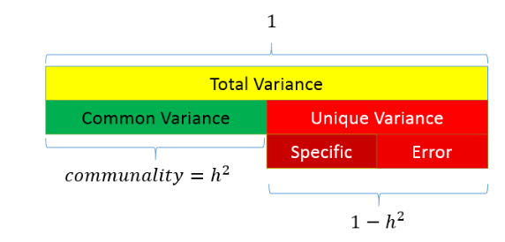
Partitioning the variance in factor analysis
Common variance is the amount of variance that is shared among a set of items.
Unique variance is the portion of variance that is not common
  Specific
  Error
Total variance = common + unique
You want communality to be high and uniqueness to be low
Ranges from 0 to 1
Higher values = the common factor
explain more of the variance of an individual
item

Slide 16
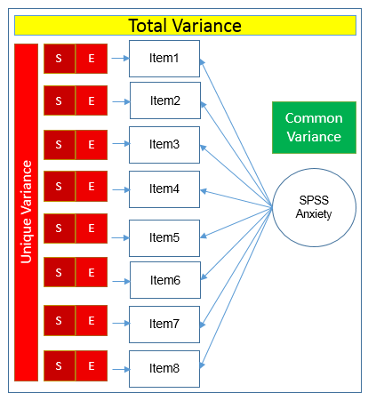
Example
Statistics anxiety makes up the common variance for all 8 items
Within each item there is
  Specific variance
  Error variance
Stats Anxiety

Slide 17
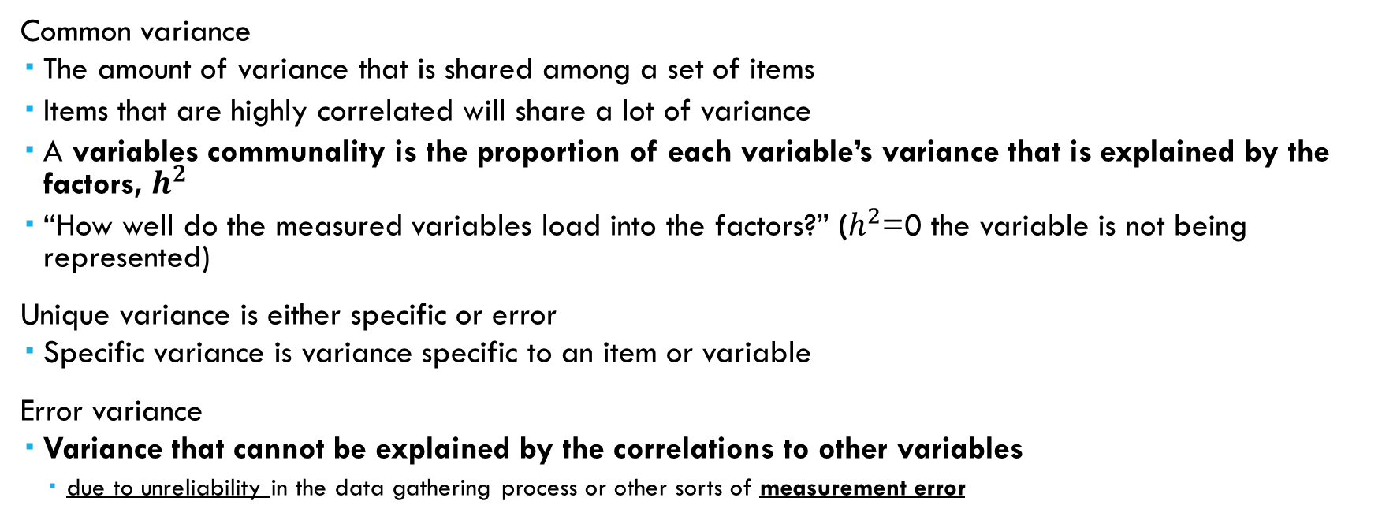
Extracting a set of factors from the correlation matrix
Common variance
  The amount of variance that is shared among a set of items
  Items that are highly correlated will share a lot of variance
  A variables communality is the proportion of each variable’s variance that is explained by the factors, $h^{2}$
  “How well do the measured variables load into the factors?” ($h^{2}$=0 the variable is not being represented)
Unique variance is either specific or error
  Specific variance is variance specific to an item or variable
Error variance
  Variance that cannot be explained by the correlations to other variables
    due to unreliability in the data gathering process or other sorts of measurement error

Slide 18
Exploratory Factor Analysis Specification Conditions & Decisions
Factor retention: once the variables are factored, we need to determine how many factors to retain
  This is a “crucial decision”
Notes:
If too few factors are retained, then important information is lost and important factors may be neglected
Remember the goal is parsimony

Slide 19
Full Set of Criteria for number of factors
Note: some of these are statistical, some require common sense judgment
Selecting the factor(s)
  A priori criterion
  Scree plots
  Kaiser’s rule (eigenvalues greater than one)
  Parallel analysis
  Number of variables per factor
  Heterogeneity of the respondents

Slide 20
Kaiser’s rule (eigenvalues greater than one)
Eigenvalues measure the amount of variance in the total sample that is accounted for by each factor
Retain only those eigenvalues that are greater than 1 and drop the rest
Why? Any value greater than one represents a factor that explains a higher-than-average amount of variance

Slide 21
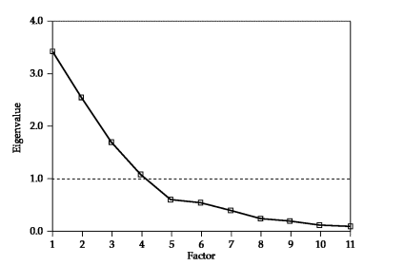
Scree plot
Look to see where the ‘elbow’ bends in the plot – that is how many factors to retain
  To do this look for the clearest delineation of where the line goes from being diagonal to horizontal
  Then count the number of lines
  This is a matter of judgment I would look at 4, 5 and 6 and the use theory to guide
  Better than Kaiser’s rule (eigenvalues greater than one)

Slide 22
Parallel Analysis**
Compare the eigenvalues from the original data to the eigenvalues generated from a Monte Carlo simulated matrix created from randomly generated data of the same sample size
Factors are retained when the i^{th} eigenvalue from the observed data is greater than the i^{th} eigenvalue from the random data
Superior to both previous methods
SPSS doesn’t provide this – do it in JASP

Slide 23
Interpreting the factors
An iterative process
Begins with estimating the factor matrix
  First the initial unrotated factor matrix is computed containing the factor loadings
    An unrotated factor solution simply tries to explain the maximum amount of variance with a minimal number of factors
  Rotated factor loadings are the correlation of each variable and the factor
    Indicate the degree of correspondence between the variable and the factor – higher loadings indicate that variable is more representative of the factor
    This is how you interpret the factor, by looking at rotated factor loadings it provides meaning to the unrotated factor matrix

Slide 24
Factor Rotation
Rotation means that the axes are placed in a different position by turning about the origin
Rotation serves only to clarify and improve the ability to interpret the solutions by more clearly differentiating the factor loadings
Two kinds
  Orthogonal produces uncorrelated factors
  Oblique rotates the factors independently of each other at different angles
    Produces correlated factors not variables
    Increases the difficulty in attaching meaning
    Nevertheless, use this technique and not orthogonal as the assumption that the factors are not correlated is UNREALISTIC for social work/social sciences…
Notes:
Increases the difficulty in attaching meaning because it will yield an increased number of cross-loadings where some variables will have similar factor loadings for multiple factors

Slide 25
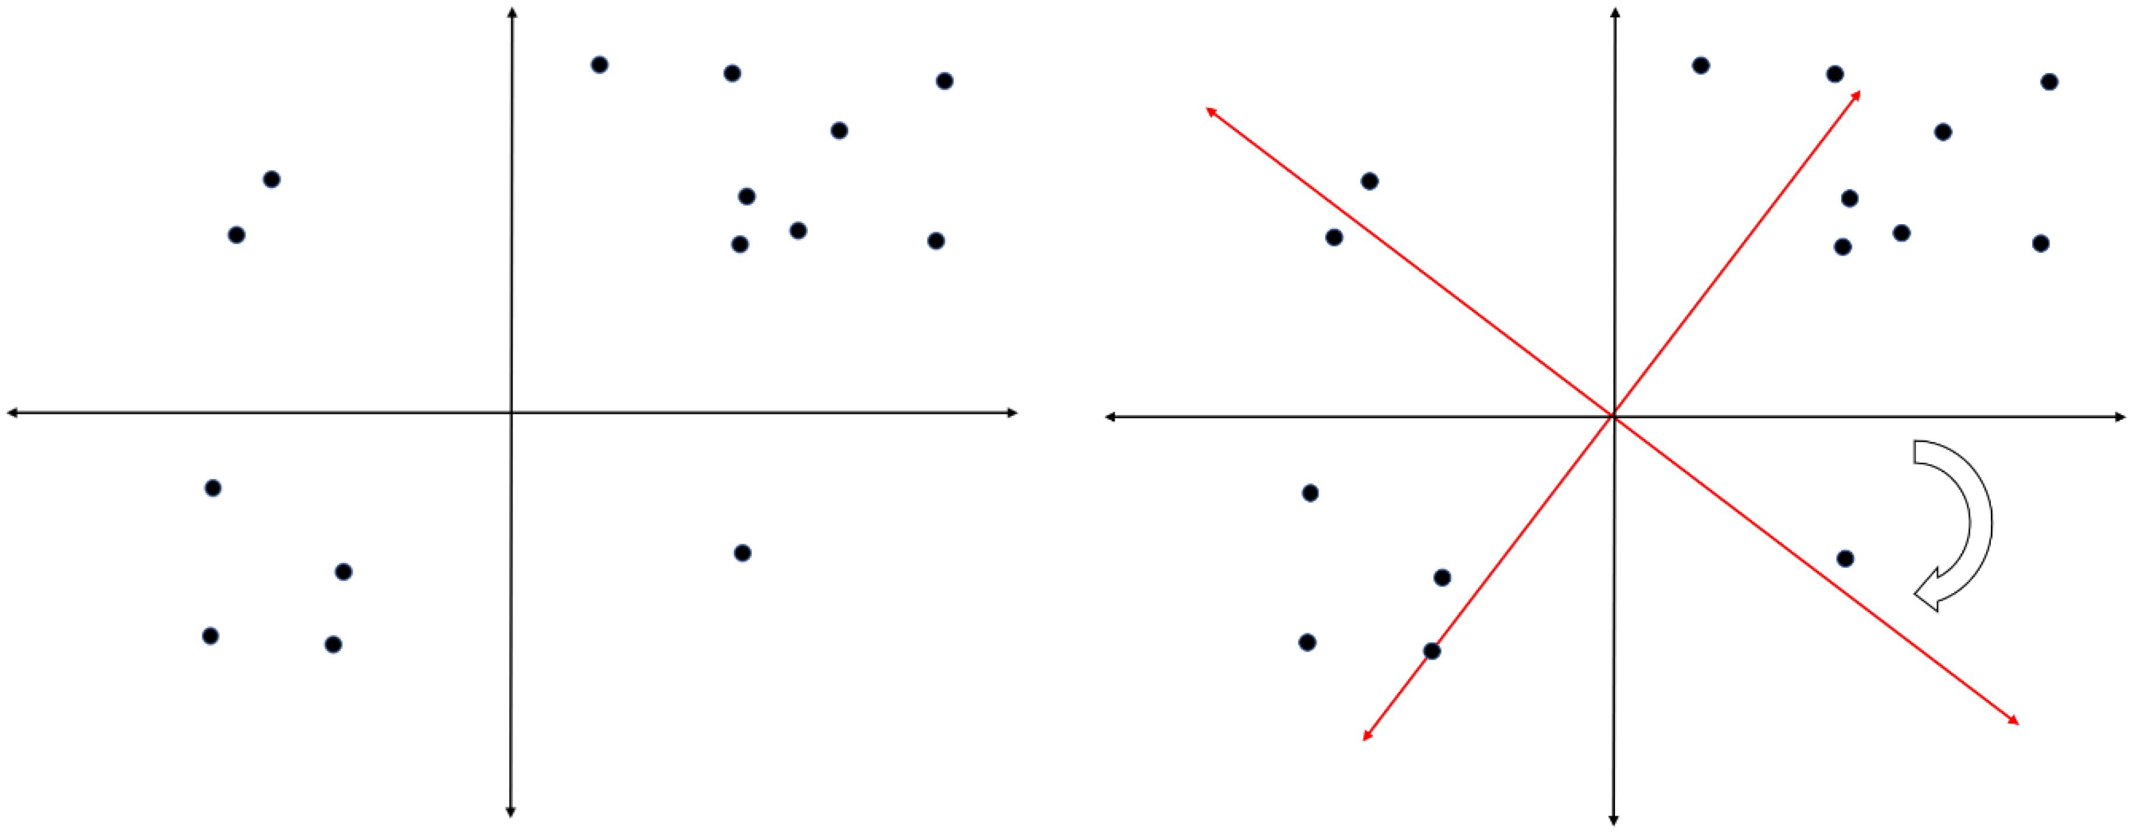
Rotation (Cont’D)
When more than one variable loads highly on a factor the interpretation becomes difficult (as we will see)
It is a good idea to find an appropriate rotation that makes the factors more interpretable
The best way to understand this is by a scatterplot matrix of the factor loadings – the goal is to find a rotation such that each of the variables has a high loading on only one factor

Slide 26
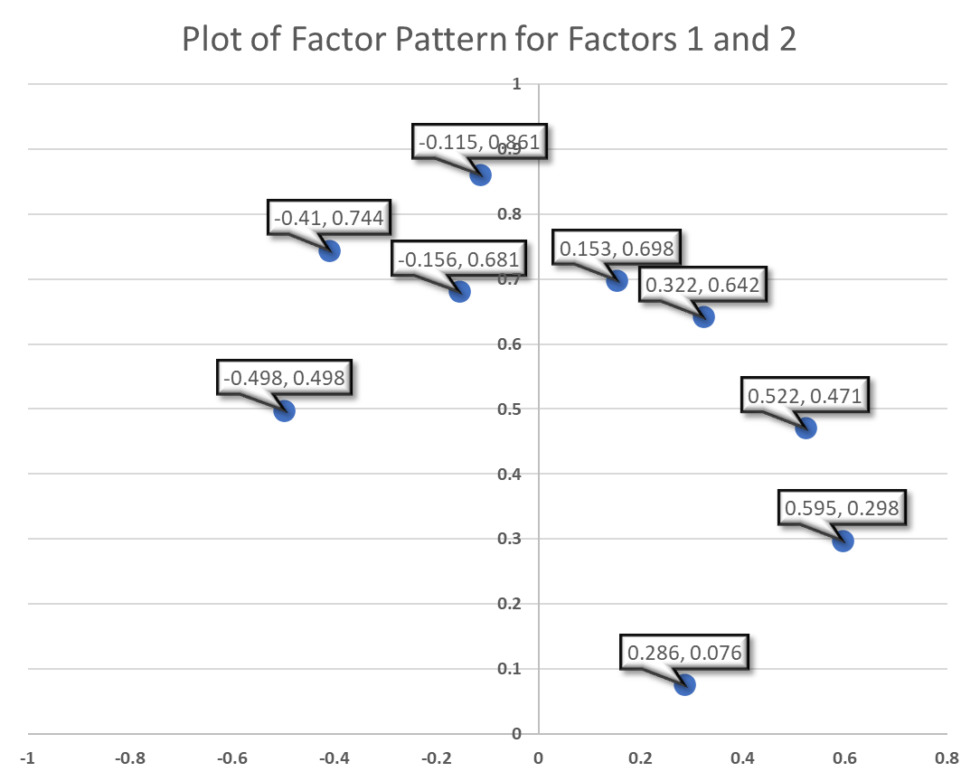
Example
Factor
Variable | 1 | 2 | 3
Climate | 0.286 | 0.076 | 0.841
Housing | 0.698 | 0.153 | 0.084
Health | 0.744 | -0.41 | -0.02
Crime | 0.471 | 0.522 | 0.135
Transportation | 0.681 | -0.156 | -0.148
Education | 0.498 | -0.498 | -0.253
Arts | 0.861 | -0.115 | 0.011
Recreation | 0.642 | 0.322 | 0.044
Economics | 0.298 | 0.595 | -0.533
Notes:
Ideally, each variable appears in only one column
Rotation involves defining new coordinate systems so that when we rotate everything, the points fall close to the vertices (end points) of the new axes.

Slide 27
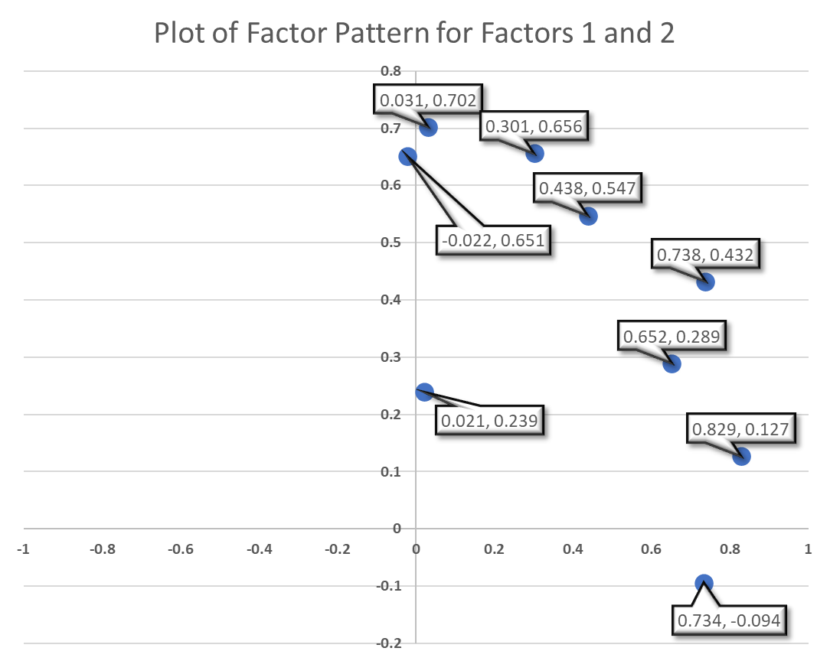
Example
Factor
Variable | 1 | 2 | 3
Climate | 0.021 | 0.239 | 0.859
Housing | 0.438 | 0.547 | 0.166
Health | 0.829 | 0.127 | 0.137
Crime | 0.031 | 0.702 | 0.139
Transportation | 0.652 | 0.289 | -0.028
Education | 0.734 | -0.094 | -0.117
Arts | 0.738 | 0.432 | 0.15
Recreation | 0.301 | 0.656 | 0.099
Economics | -0.022 | 0.651 | -0.551
Notes:
Ideally, each variable appears in only one column
Rotation involves defining new coordinate systems so that when we rotate everything, the points fall close to the vertices (end points) of the new axes.

Slide 28
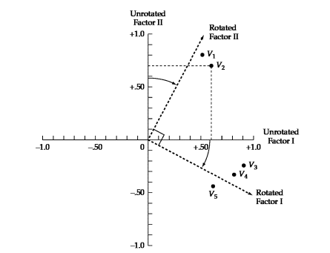
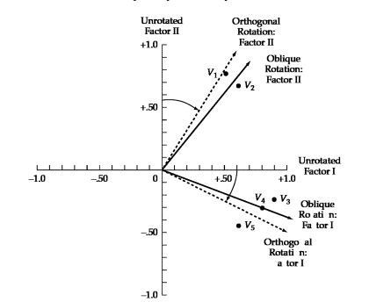
This has the effect of
making the factor loading pattern much clearer
Orthogonal rotates 90º
Comparison Between Rotated and Unrotated Factor Loadings
 | Unrotated Factor Loadings |  | Rotated Factor Loadings
Variables | I | II | I | II
V1 | .50 | .80 | .03 | .94
V2 | .60 | .70 | .16 | .90
V3 | .90 | -.25 | .95 | .24
V4 | .80 | -.30 | .84 | .15
V5 | .60 | -.50 | .76 | -.13
Oblique
Notes:
Factor rotation means that the axes are being rotated so that the clusters of items fall as closely as possible to them.
Imagine rotating the axes so that they intersect the centroid of each cluster variables to get the essence of rotation.
Rotation means that the reference axes of the factors are turned about the origin until some other position has been reached
The effect is to redistribute the variance from earlier factors to later ones to achieve simpler and more meaningful factor pattern
The simplest case is orthogonal factor rotation where the axes are maintained at 90 degrees
When not constrained to being orothogonal the rotation procedure is called oblique
following rotation of the axes, the items now fall closer to each axis line
You can see that after rotating the factor axes, variables 3,4 and 5 load high on factor I and 1 and 2 load high on factor II
Notice too that the oblique factor rotation represents the clustering of variables more accurately because each rotated axis is now closer to the respective group or variables

Slide 29
Factor loadings
The factor loading provides information on the relative contribution that an individual variable makes to a factor
Should be >=.3 preferably >=.4, closer to 1 is better
The factor loading squared is the percentage of common variance of the factor that is accounted for by that variable
In a perfect world, a variable will have a large coordinate on one factor and low on all others – never happens
Negative factor loadings are possible (may want to recode)
Bipolar factors: factors defined by both positive and negative loadings
Notes:
Try: the % of variance in all the variables accounted for by each factor is computed as the sum of the squared factor loadings for that factor divided by the number of variables – which is also the same as dividing the eigenvalue of a factor by the number of variables in the model

Slide 30
Judging the significance of the factors
Ensuring the practical significance
The larger the more important, using practical reasoning
  +/- .30 to +/- .40 meet minimum level for interpreting factor structure
  Loadings of .50 or higher are practically significant
  Loadings > .70 are indicative of well-defined structure

Slide 31
Identify Significant loadings and assess communalities
Once the significance of loadings has been identified, look for any variables that are not adequately accounted for by the factor solution
We do this by looking at communalities → variables with communalities less than .50 do not have sufficient explanation
If low communalities are identified, remove the variable and repeat the analysis
Then label the factors

Slide 32
Interpreting a factor Matrix
Find distinctive variables for each factor and look for correspondence to the conceptual foundation
Note: if an oblique rotation has been used two matrices of factor loadings are provided
  The factor pattern matrix contains loadings representing the unique contribution of each variable to the factor
  The factor structure matrix contain loadings with both unique variance between variables and factors and the correlation among factors

Slide 33
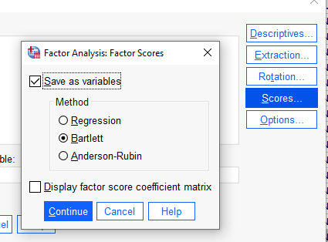
Generating factor scores: A Composite Measure
Sometimes you would like to use the factor scores as a predictor in another analysis
This can be done in SPSS
SPSS will append variables to your dataset for each factor
For oblique rotations, use regression method
This variable can be used in a different analysis
The scores are standardized, mean = 0, var = 1

Slide 34
Considerations
Guidelines
  high communalities (approximately .8 to .9)
  low model error (which is likely evidenced in situations where communalities are high; RMSR = .00 to .06) (Preacher & MacCallum, 2002)
  factors with four or more variables with factor loadings of .60 or greater are interpretable regardless of the sample size
  solutions with lower factor loadings (.40) can still be interpreted if the number of cases is at least 200 and the number of variables per factor is larger (=> 10)

Slide 35
Assumptions
Assumption | Effect when violated
Independence | Influences standard errors and hypothesis tests
Linearity | Reduces interpretability of the FA solution
Absence of outlying cases and variables | Exerts undue influence on and distorts the FA solution
Lack of extreme multicollinearity | Reduces ability to separate effects of variables
Multivariate normality | Minimal effect except when MLE is used and when samples size is small
10 observations per variable/n >= 200
Homogeneity of the sample** | Failure to consider groupings
Notes:
Measurement scale
Assumption: a correlation matrix can be calculated from the variables
This matrix is a Pearson matrix (i.e. a linear relationship exists)
Only use ordinal items if they meet the assumption of linearity
This will mostly be never → use LCA/LPA
Sample Size
Minimum of 10 observations per variable
At least 200 cases
Homogeneity of the sample in relation to the underlying factor structure
The sample must be homogenous with respect to the underlying factor structure
Example
If the sample differs on some known characteristic, on the variables you are analyzing then perform separate groups analysis
Example: 20 ratings gauging individual attitudes towards police, do group analysis using race/ethnicity as the grouping variable

Slide 36
Factor Analysis in SPSS
Factor analysis in spss.doc
We will use data from the Program for the International Assessment of Adult Competencies (PIAAC) located here Data - PIAAC, the OECD's programme of assessment and analysis of adult skills
The subsetted spss file is called sub_prgusap1_2017.sav

Slide 37
Cross Cultural Invariance Testing
Most questionnaires were developed in a Western context
  But how do we know that the questionnaire measures the same thing across different groups?
  Invariance across groups: does the test measure the latent variable in the same way across groups?

Slide 38
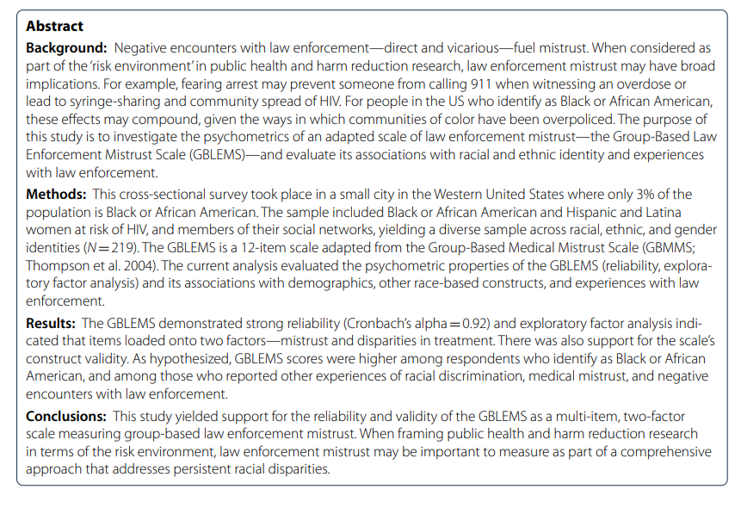
Johnson, L. M., Devereux, P. G., & Wagner, K. D. (2022). The group-based law enforcement mistrust scale: psychometric properties of an adapted scale and implications for public health and harm reduction research. Harm Reduction Journal, 19(1), 1-13.

Slide 39
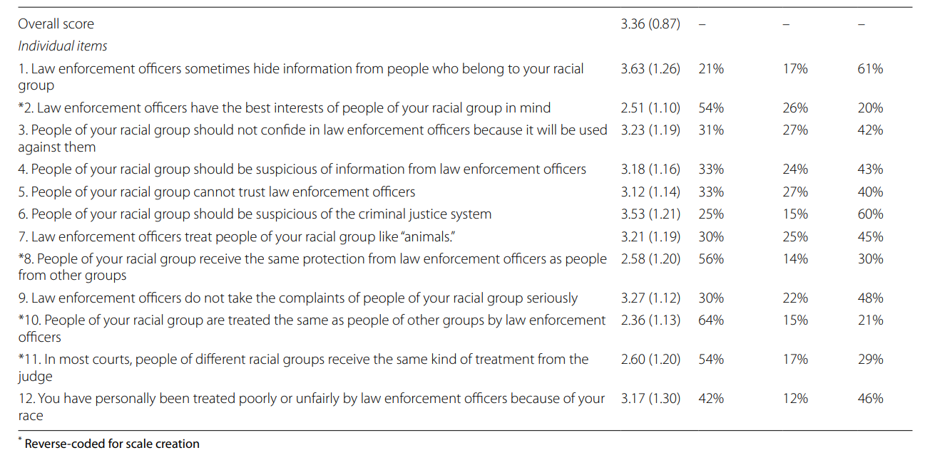
Disagree
Neutral
Agree

Slide 40
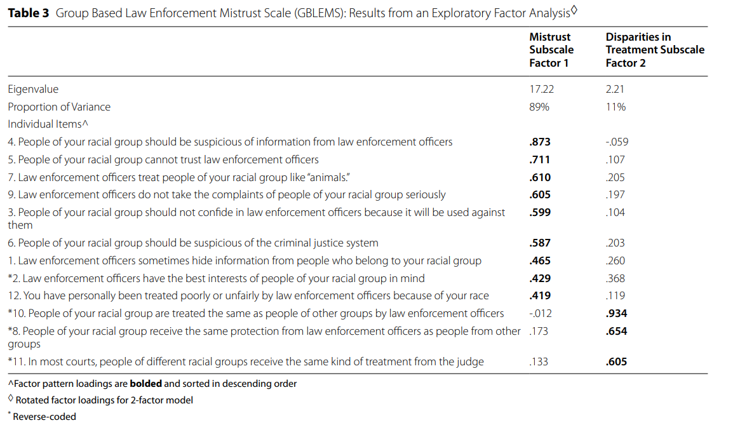

Slide 41
In class assignment
In class assignment.doc
We are going to explore the racial identity scale using data from Generations: A Study of the Life and Health of LGB People in a Changing Society, United States, 2016-2019 (ICPSR 37166)
The file is ‘life and health of lgbt people study.sav’

Slide 42
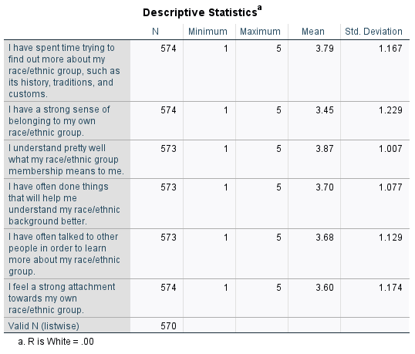
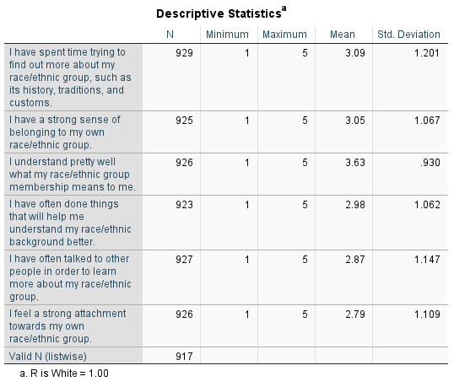

Slide 43
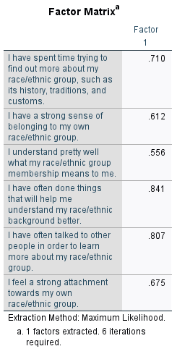

Slide 44
